Slide 1
Mobile and Web Multimedia
CT08-3-3 & Version VC1
Mobile Technologies

Slide 2
Topic & Structure of The Lesson
Overview of mobile technologies
Advantages of mobile devices
Challenges
CoMobile, collaborative tasks with mobile phone
Conclusion

Slide 3
Learning Outcomes
At the end of this topic, You should be able to:
Identify the key factors in 3G applicaitions
Examine the challenges involved in 3G applications
Identify issues and constraints for 3G services

Slide 4
Key Terms You Must Be Able To Use
If you have mastered this topic, you should be able to use the following terms correctly in your assignments and exams:
3G applications

Slide 5
Introduction
Mobile technology is a form of technology that is mostly used in cellular communication and other related aspects.
It uses a form of platform where by many transmitters have the ability to send data at the same time on a single channel.

Slide 6
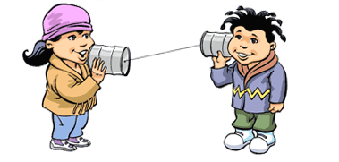
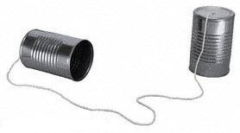
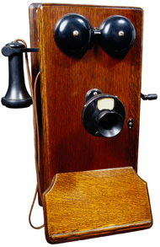
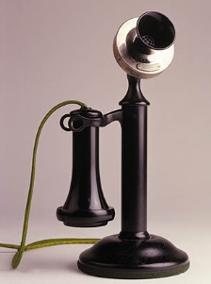
Device for voice communication
Alexander Graham Bell (1876)

Slide 7
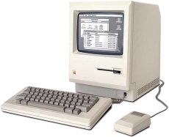

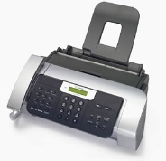

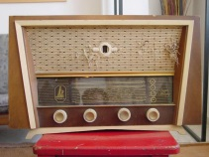
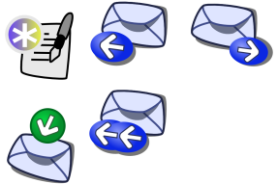
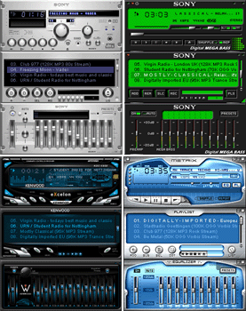
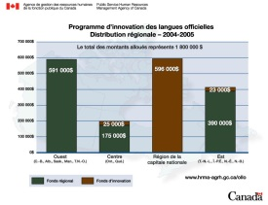
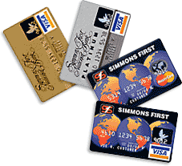
Everyday life‘s tools
Computer
Fax
Radio
Email
Music player
Word processor
Credit cards

Slide 8
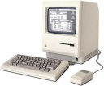
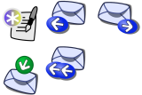
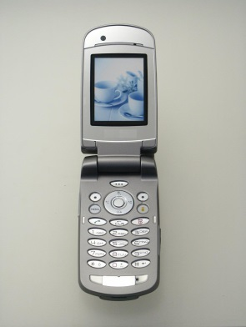
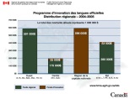
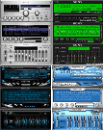
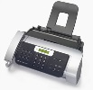

Everyday life‘s tools
Mobile phones are first introduced in mid 1980s
Computer
Email
Word processor
Music player
Smart phone
Additional features can be installed
Fax
Radio

Slide 9
Mobile applications
Banking (check balance, make transaction)
Restaurant (order and payment)
Mobile Payment (ticket, vending machine)
Tourism: tourist guide
Education: mobile learning
Entertainment: interactive digital art
Scientific: controlling and monitoring

Slide 10
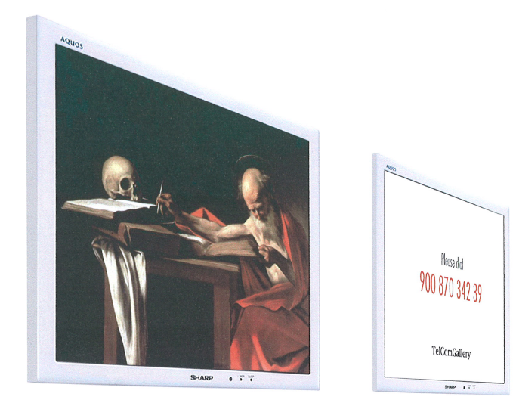
Interactive Digital Art - TelcomGallery
Use mobile phone to interact with the object:
- Pressing the phone's keys
Speaking to the phone,
Or simply holding the call.
Voice of the user can change the audio-visual
parameters of the digital artworks in real-time

Slide 11
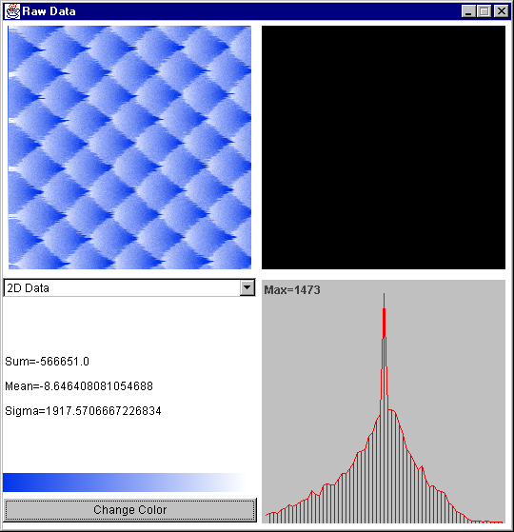
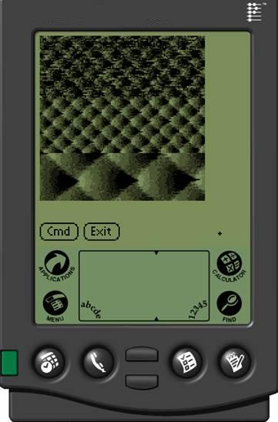
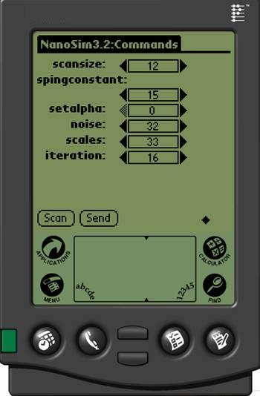
Mobile devices as remote control

Slide 12
Advantages of mobile devices
Accessible anywhere, anytime
Conveniently controlling and monitoring
Instant notification
Easy to exchange data and information

Slide 13
Challenges
Small screen-size (will remains)
Limited input facilities (will remains?)
Diverse software environments:
OS (Symbian, Linux, Windows Mobile), Language (J2ME, BREW, C++)
Limited bandwidth (will be solved):
GSM->GPRS->UMTS, CDMA, WiFi

Slide 14
Question
How can we use mobile devices efficiently?
(One answer is in next slides)

Slide 15
Uni Basel-CoMobile overview
Collaboration between: web clients and mobile clients
Diverse communication channels:
SMS, MMS, Voice, WAP, HTTP, Bluetooth
Modularity: flexible and extendable

Slide 16
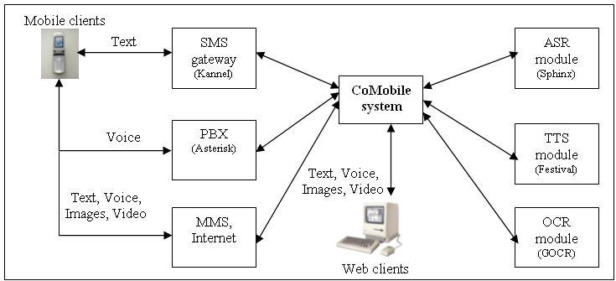
Uni Basel-CoMobile architecture

Slide 17
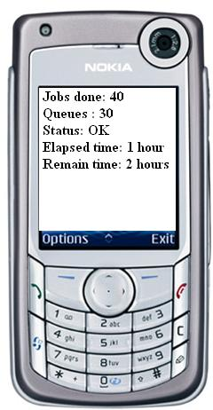
Example
Jobs done: 40
Queues : 30
Status: OK
Elapsed time: 1 hour
Remain time: 2 hours
Short text can be sent via SMS
What about this text?
Client-side globus-hostname command is not returning a fully qualified domain name (FQN).
The submission scripts use globus-hostname to send information to the server about how to contact the client.
The fix is to make globus-hostname return the FQDN.
There are firewalls and ports (GRAM: 2119, LDAP: 2135) which are not open.
Check that GLOBUS_TCP_PORT_RANGE is set to 3000 to 3090 on the client
(or another range acceptable for the server to contact the client on),
and that all intermediate firewalls are open for this range in both directions.
GRAM Job submission failed because the executable file permissions do not allow execution".
Probable cause: You submitted a script, e.g., globus-job-run symphony:2119/jobmanager-loadleveler $PWD/simple.
ll but simple.ll does not have the execute permission bit set.
The error msg "Authentication Failed remote certificate signed by unknown CA"
means the client cannot find the CA for the cert presented by the server.
Make sure the CA cert is present in the trusted cert dir set with setup-gsi.
Also, check the time is consistent across the machines.
The error msg "GRAM Job submission failed because the connection to the server failed (check host and port)
Make sure that the gatekeeper service is enabled.
The error msg "GRAM Job submission failed because data transfer to the server failed"
means the job manager has problems opening some file.
Make sure $GLOBUS_LOCATION is readable by all the users (mode 755)

Slide 18
Uni Basel-CoMobile demo
Demo : Text to Speech, and access via phone

Slide 19
Uni Basel-CoMobile features
Data submission: send information (text, images, audio, video) via SMS, MMS, voice recording.
Receive SMS notification (replies, reminds, alerts).
Access information via various channels: Voice, SMS, MMS, WAP, Bluetooth.
Search on multimedia contents.

Slide 20
Search with CoMobile
Search on multimedia content
(video, audio, picture):
Using metadata
Automated speech recognition (ASR)
Optical character recognition (OCR)

Slide 21
Conclusion
Mobile devices are being used in various kinds of applications.
Uni Basel-CoMobile: an useful framework that support collaborative activities with mobile devices.
CoMobile is designed for extension and integration with other systems.

Slide 22
Discussion
Cost: Users have to pay for SMS, MMS, as well as voice call. „Flat rate“ package will be common in the near future.
Storage: 1 minute video = 1 MB (approximately). There exists 2GB flash card for mobile phone
Bandwidth: 14.4 kbps (GSM), 140 kbps (GPRS), 1920 kbps (UMTS)

Slide 23




SMS gateway - Kannel
HTTP request to forward SMS Text
RS-232
AT Commands
AT+CNMI=1,2,0,1,1
SMS Text

Slide 24

MMS gateway - Mbuni
Mbuni
HTTP request to forward MMS
RS-232
AT Commands
AT+CNMI=1,2,0,1,1
MMS
Text, Picture, Audio

Slide 25

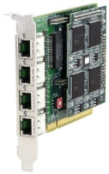
PBX Asterisk
AGI: Perl, Java, PHP scripts are called
Voice
PCI socket
Telephone line

Slide 26
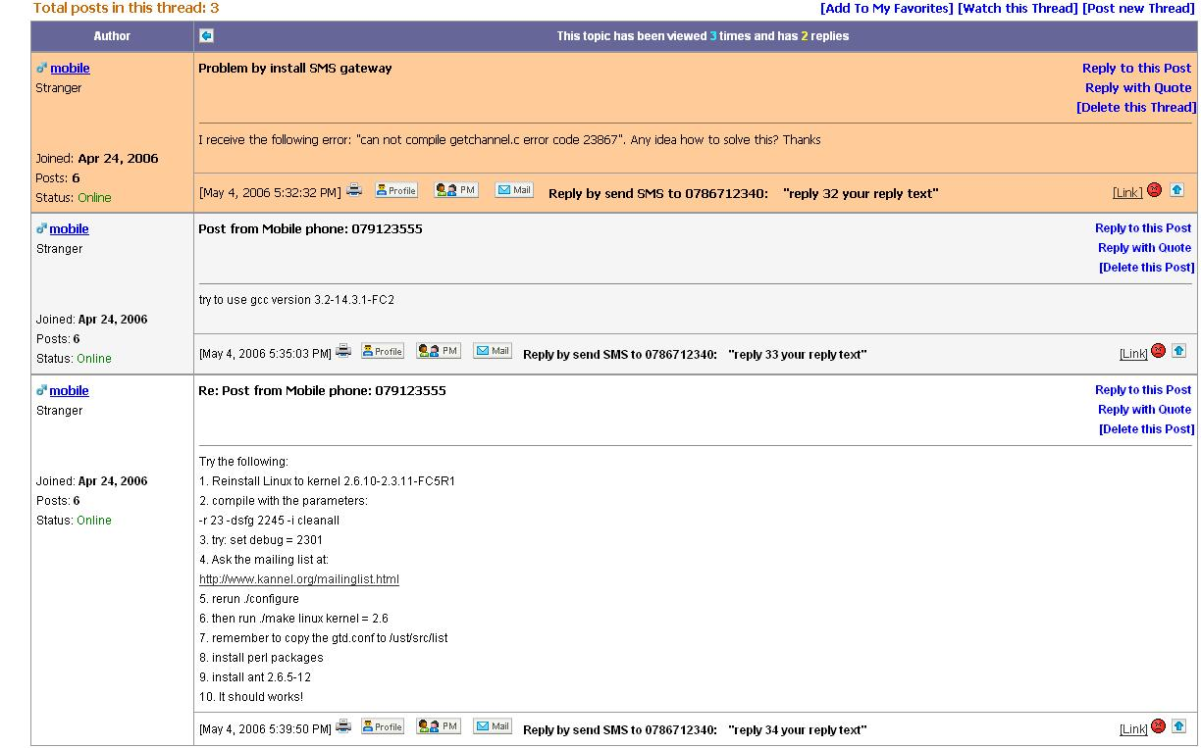
Uni Basel-CoMobile-Demo

Slide 27
Quick Review Question
Give ONE key factor in 3G applications.
Differentiate ‘killer’ applications, consumer and business applications. Give ONE example to support your answer.

Slide 28
Summary of Main Teaching Points
Advantages of mobile devices
Challenges
CoMobile, collaborative tasks with mobile phone

Slide 29
Question and Answer Session
Q & A

Slide 30
What we will cover next
Web 2

